Slide 1
UB AI Hackathon BCAT Workspace
The 2 AI Geeks
Gokul Ram Subramani
Keshav Kumar Prabhakharan

Slide 2
Challenge Statement
BCAT recently relocated to a new office space, where different departments and services are now spread across multiple floors. This physical separation has led to challenges in maintaining cross-departmental collaboration, increasing the risk of teams working in silos. The goal is to leverage generative AI to enhance communication, foster collaboration, and break down these barriers, creating a more integrated and cohesive work environment.

Slide 3
Solution Overview
To address BCAT’s need for improved cross-department collaboration, we developed an AI-powered Collaboration Hub integrated with Google Workspace. The hub is designed to centralize communication and resource sharing while utilizing generative AI to enhance efficiency and knowledge flow across teams.

Slide 4
Key Features and Functionalities:
Personalized Employee Dashboard:
Each user has access to a customized homepage with direct links to Google Chat, Google Meet, and Gmail, along with notification indicators showing unread messages.
This centralized hub simplifies communication management.
Flexible Scope Views:
A scope button allows employees to toggle between viewing the organization-wide board or a team-specific board, providing flexibility to focus on broader company activities or local team initiatives.

Slide 5
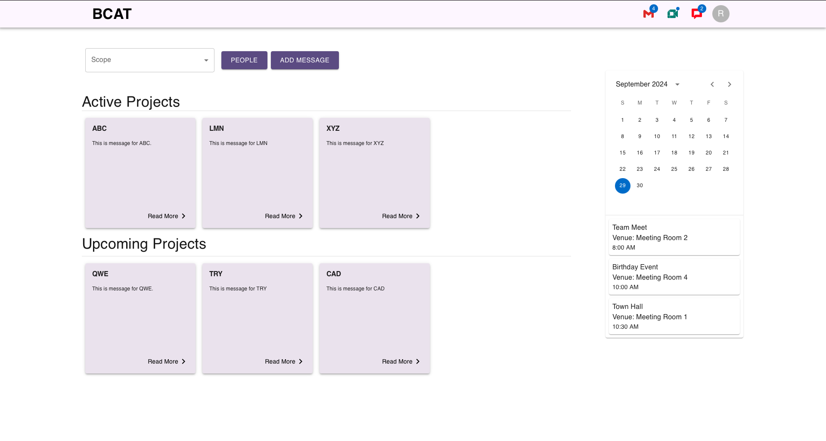

Slide 6
Key Features and Functionalities:
Project and Announcement Board:
The board is divided into two sections:
one for current projects and announcements, and
another for upcoming initiatives.
Each entry is represented by a card featuring AI-generated summaries and a “Read More” link to the full document in Google Drive.
Resource and Idea Submission:
Users can quickly share ideas, updates, or documents by clicking the “Add Resource” button.
A pop-up window lets them submit typed content or upload files (e.g., PDFs).
The system uses Generative AI to extract key information, generating summaries displayed on the board. If a meeting invite is detected, the AI prompts users to schedule it in Google Calendar for all relevant participants.

Slide 7
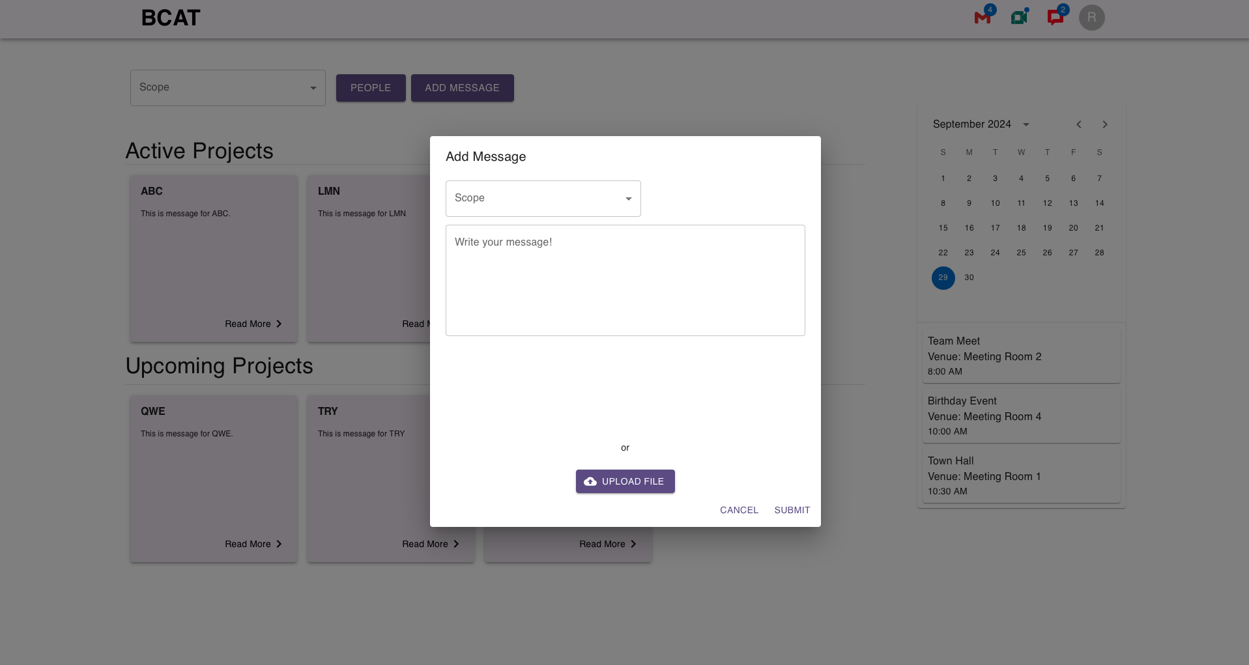

Slide 8
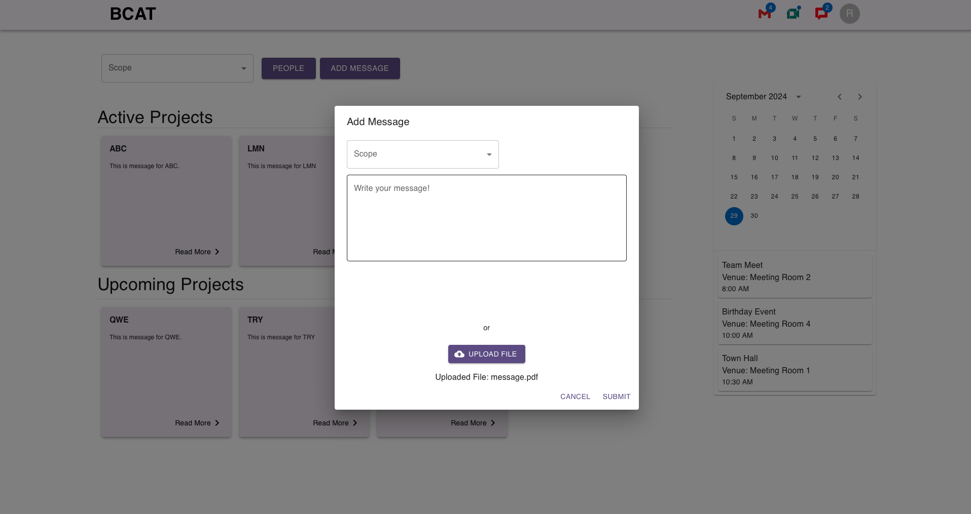

Slide 9
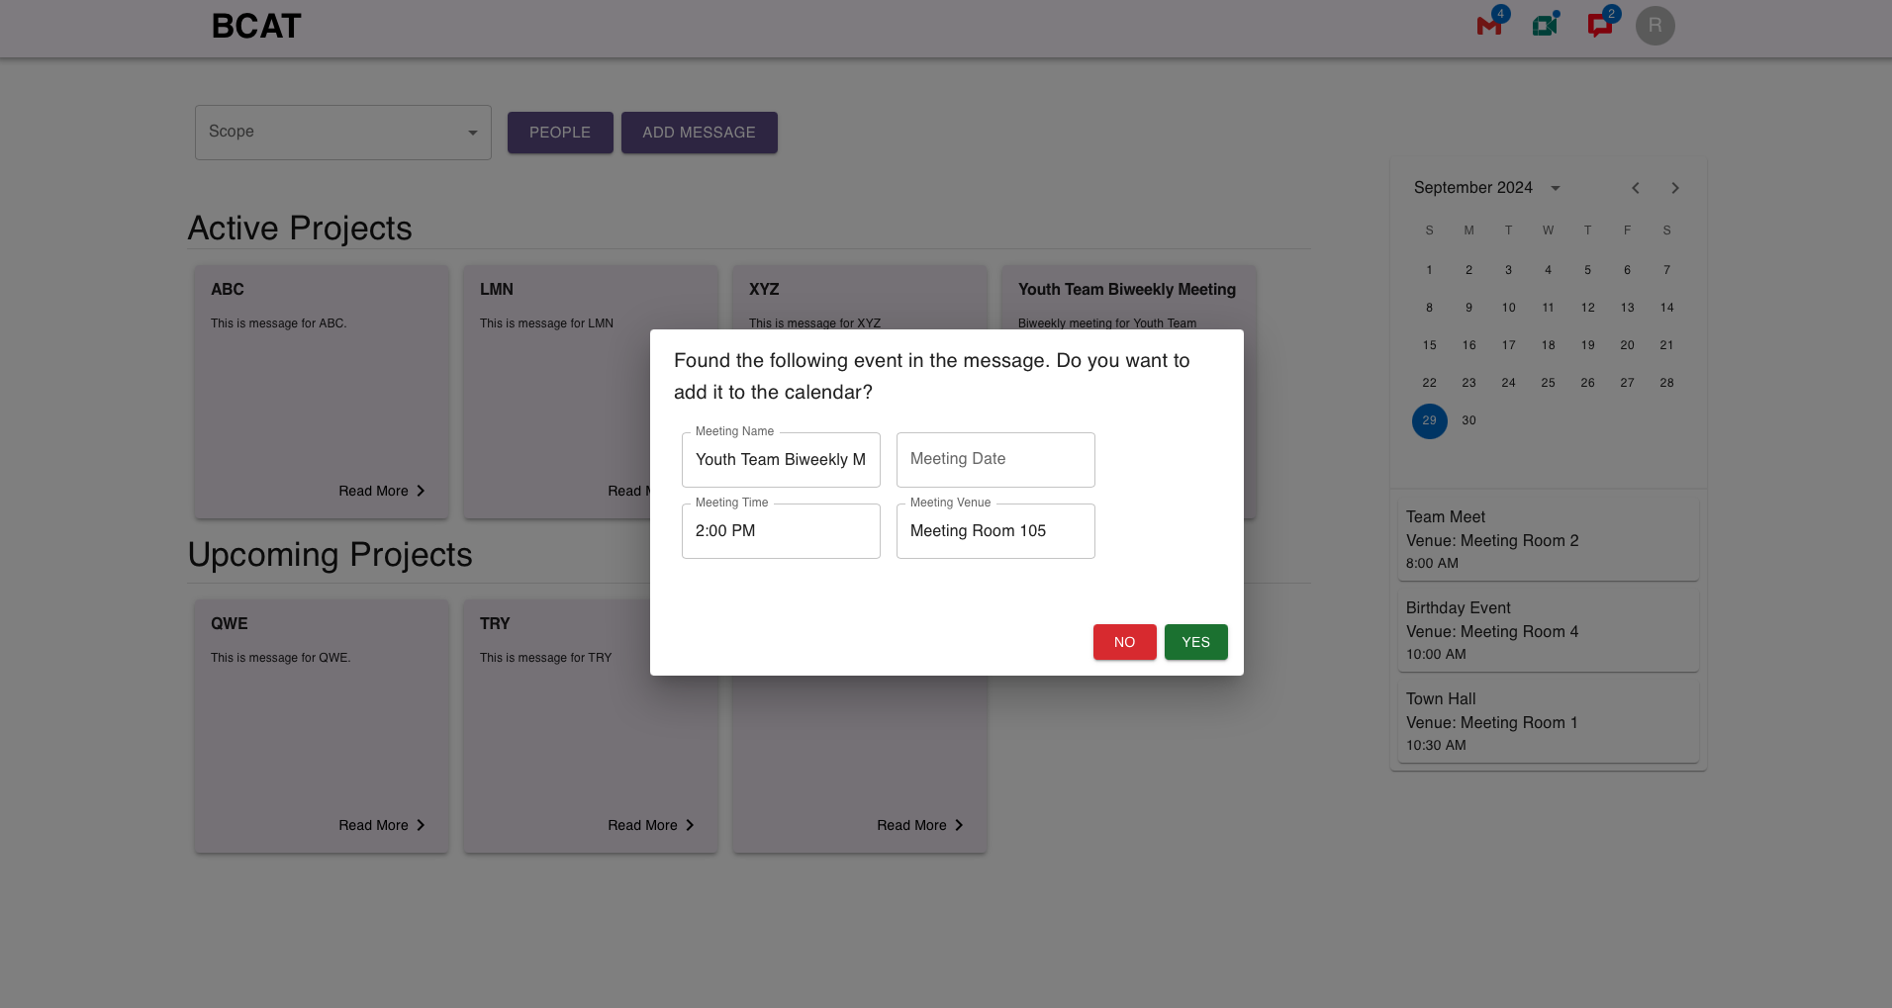

Slide 10
Key Features and Functionalities:
AI-Generated Meeting Summaries:
Google Meet’s AI automatically generates summaries of meetings, storing them in Google Drive and displaying key meeting minutes directly on the board, keeping everyone informed without additional manual work.
Weekly Insights and Progress Tracking:
The system provides weekly insights based on ongoing projects and activities across departments, displaying these updates on the board to ensure that employees stay informed and aligned on organizational progress.

Slide 11
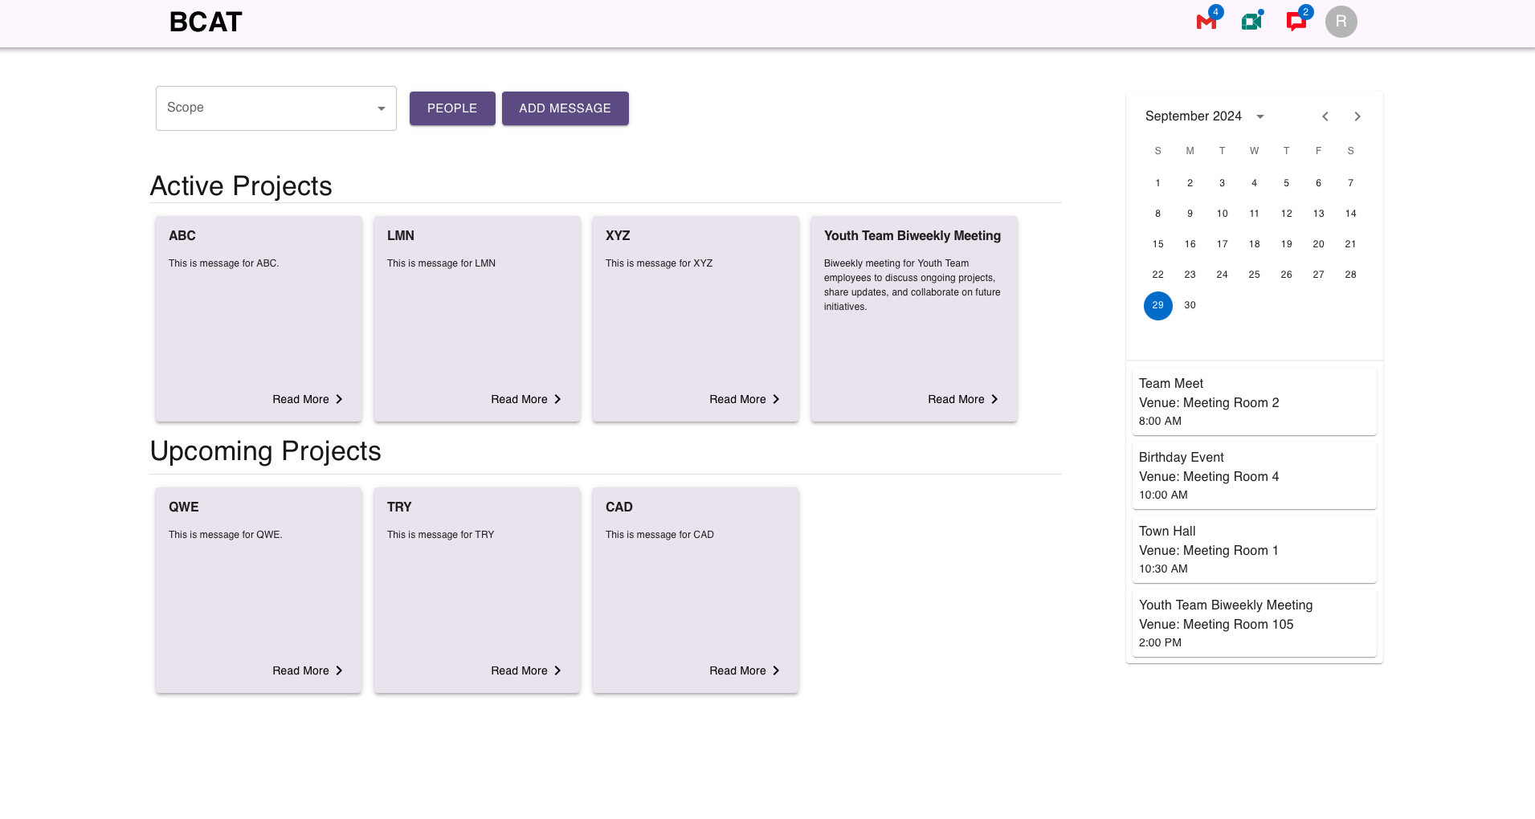

Slide 12
Key Features and Functionalities:
Employee Directory and Search:
The People section provides a searchable directory of employees, enabling users to find colleagues and access links to their Google Mail, Google Meet, and Google Chat profiles.
Users can search either globally (organization-wide) or within their specific team.
Real-Time Calendar Integration:
A live Google Calendar widget is displayed on the right side of the dashboard, synchronizing with the employee’s schedule in real-time, ensuring that meetings and deadlines are always visible.

Slide 13
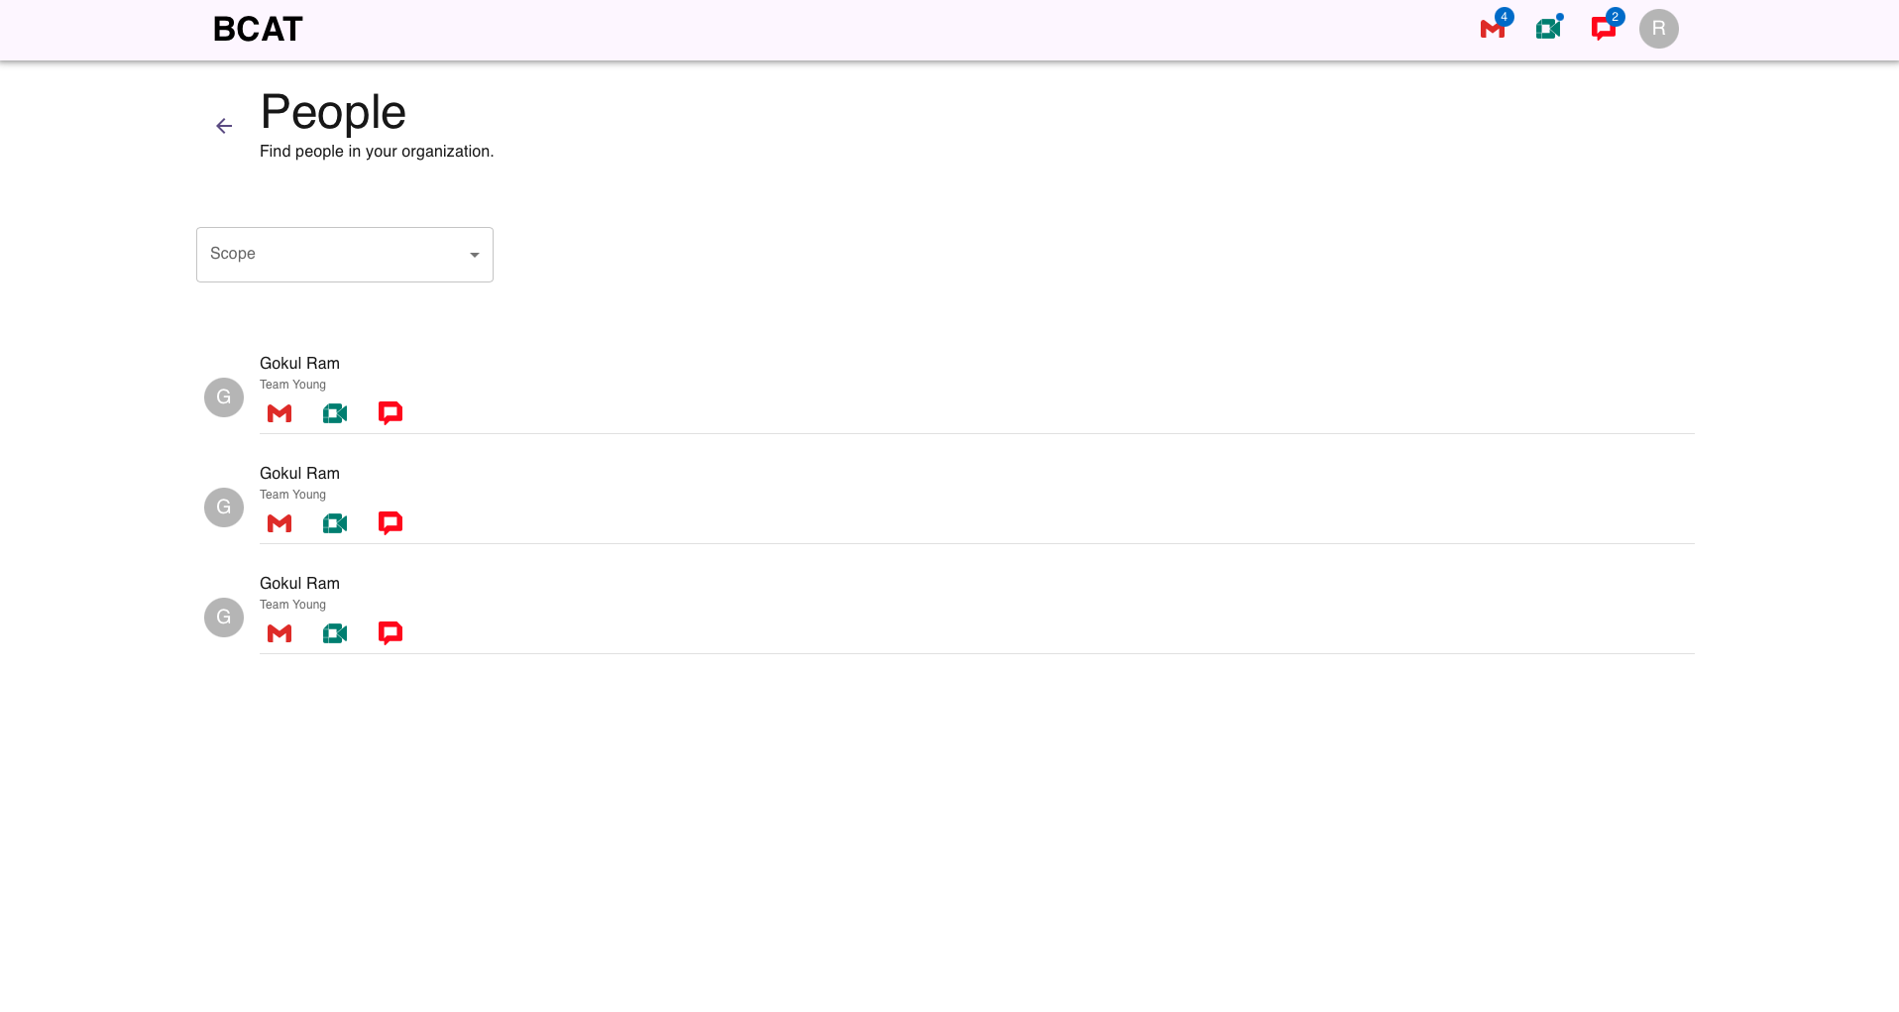

Slide 14
Modules Interaction Flow
Google Workspace Integration: All data (emails, calendar events, documents) is fetched and synced in real-time from Google Workspace.
Generative AI: AI parses user-submitted documents (ideas, PDFs, etc.), generates summaries, and manages meeting invites.
Collaboration Board: Displays ongoing and upcoming projects with AI-generated content and links to detailed documents in Google Drive.
People Directory: Integrates with Google Workspace to fetch employee details and enable easy communication.
Calendar Widget: Syncs the user’s Google Calendar with the dashboard for real-time meeting and event tracking.

Slide 15
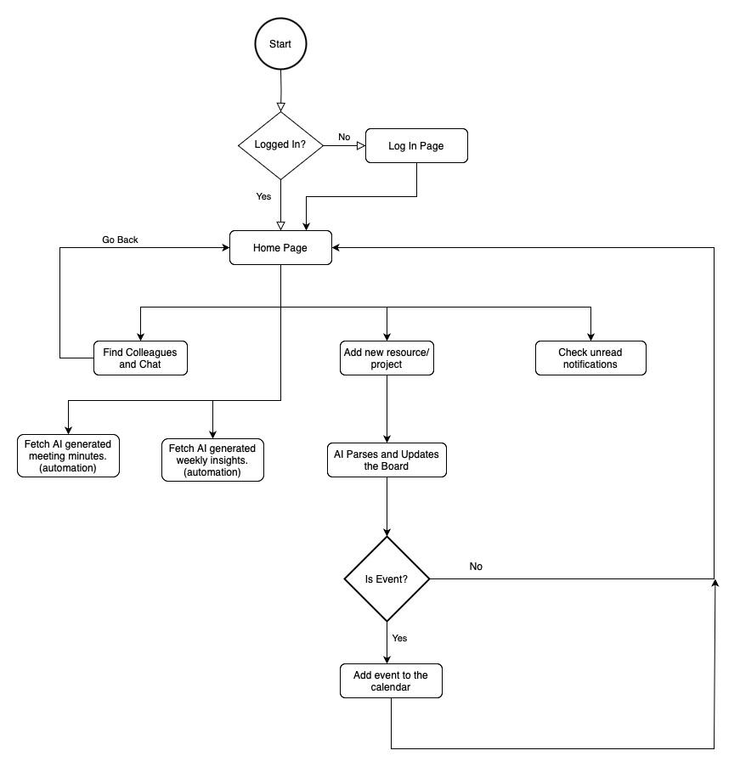
Workflow

Slide 16
Future Scopes
Integrating with popular tools and platforms used within the organization (e.g., project management software, calendars, communication apps) to create a unified workflow. This would further streamline processes and enhance collaboration.
Create a mobile version of the dashboard to ensure that employees can stay connected and engaged while on the go. This would enhance accessibility and encourage continuous collaboration, regardless of location.
Introduce advanced analytics features to track collaboration metrics, team engagement, and project outcomes.

Slide 17
Mentors
Cassie Puccia, Director, Operations, BCAT
Charisma DuBois, Director, Adult Workforce

Slide 18
Thank You
The 2 AI Geeks

